Slide 1
Improved MCNP Simulations For Use in KSU PGNAA Experiment
Vincent DiNova
NC State University
CNEC Workshop
February 7, 2019
Raleigh, North Carolina

Slide 2
Summary of Work
Utilizing CEAR (Center for Engineering Applications of Radioisotopes) cluster for extensive simulations
MCNP improvements
S(α,β) cross sections – not discussed
NaI detector activation
Process data to broaden/shift for fitting purposes
Monte Carlo Library Least Squares (MCLLS) fitting
Regularization methods (LASSO and Elastic Net)
Discussion/Questions

Slide 3
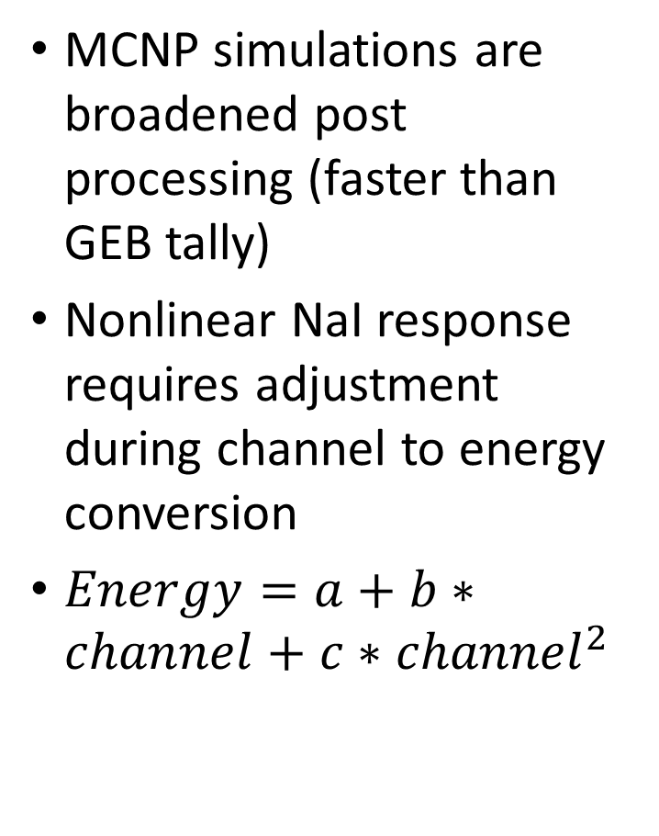
Processing of Data
MCNP simulations are broadened post processing (faster than GEB tally)
Nonlinear NaI response requires adjustment during channel to energy conversion
$Energy=a+b∗channel+c∗{channel}^{2}$

Slide 4
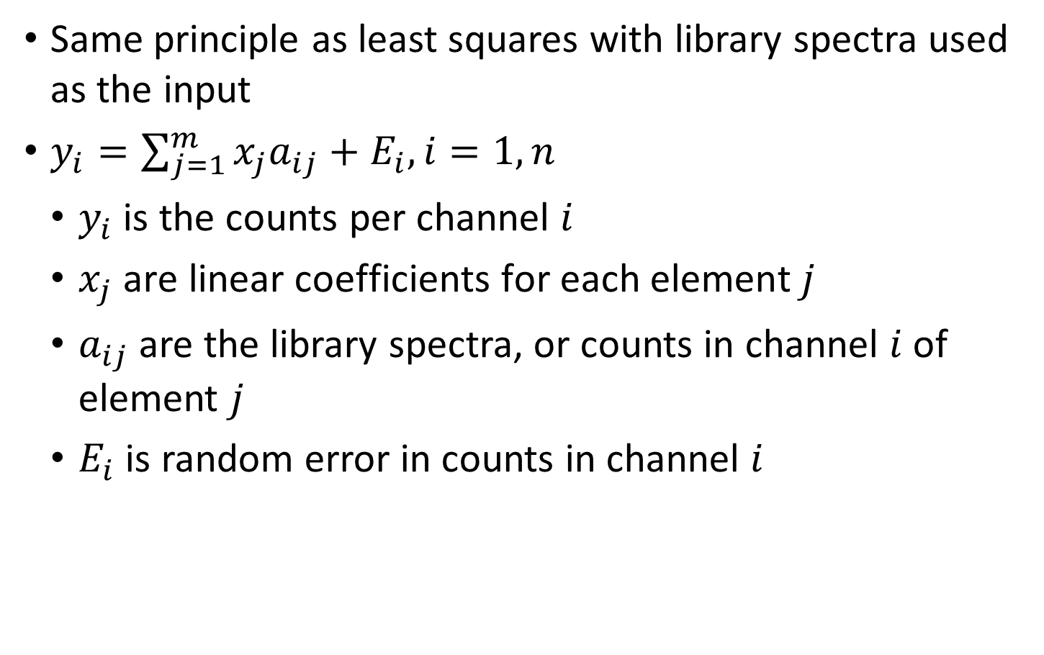
Monte Carlo Library Least Squares
Same principle as least squares with library spectra used as the input
$y_{i}=\sum_{j=1}^{m}{x_{j}a_{ij}+E_{i}, i=1,n}$
$y_{i}$ is the counts per channel $i$
$x_{j} \text{are} \text{linear} \text{coefficients} \text{for} \text{each} \text{element} j$
$a_{ij}$ are the library spectra, or counts in channel $i$ of element $j$
$E_{i}$ is random error in counts in channel $i$

Slide 5
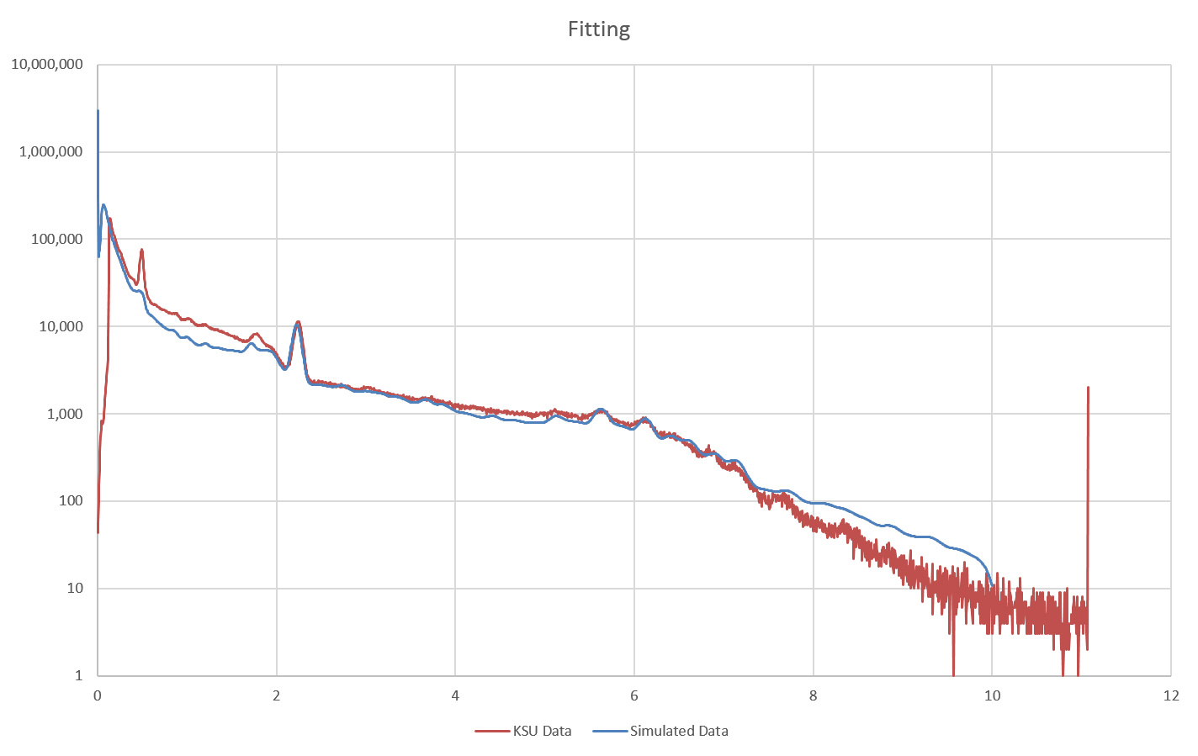
Results Without NaI Activation

Slide 6
Results With NaI Activation

Slide 7
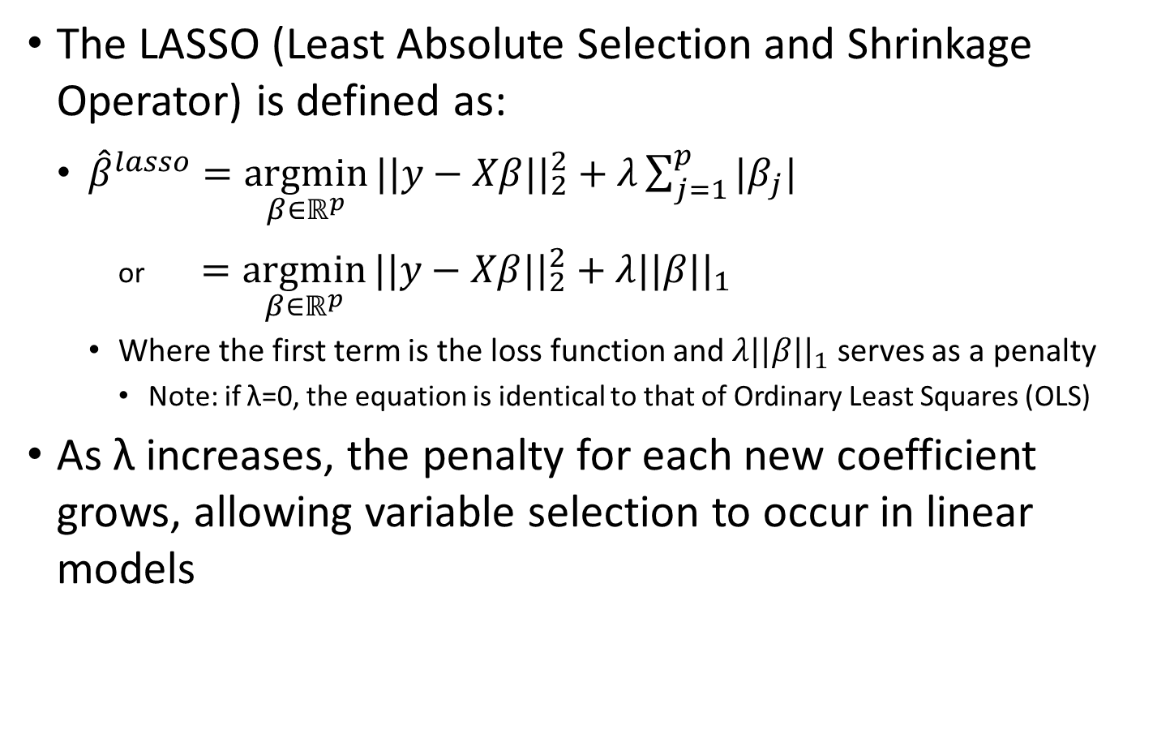
LASSO
The LASSO (Least Absolute Selection and Shrinkage Operator) is defined as:
${\hat{β}}^{lasso}=\underset{β∈ℝ^{p}}{argmin}{||y−Xβ{||}_{2}^{2}+λ\sum_{j=1}^{p}{|β_{j}|}}$
or $=\underset{β∈ℝ^{p}}{argmin}{||y−Xβ{||}_{2}^{2}}+λ||β{||}_{1}$
Where the first term is the loss function and $λ||β{||}_{1}$ serves as a penalty
Note: if λ=0, the equation is identical to that of Ordinary Least Squares (OLS)
As λ increases, the penalty for each new coefficient grows, allowing variable selection to occur in linear models

Slide 8
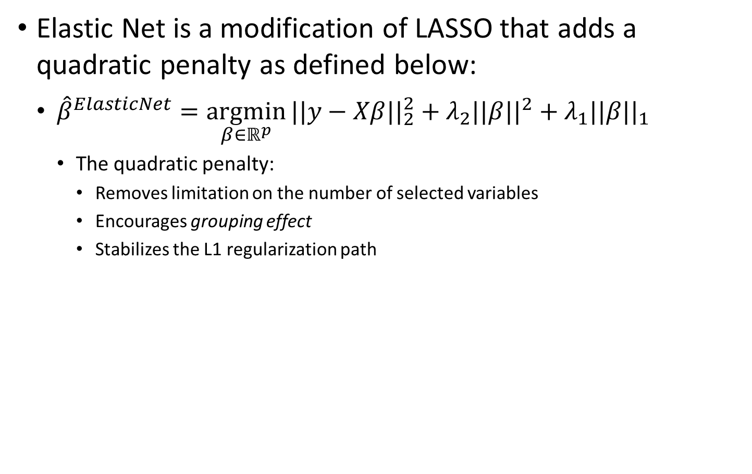
Elastic Net
Elastic Net is a modification of LASSO that adds a quadratic penalty as defined below:
${\hat{β}}^{ElasticNet}=\underset{β∈ℝ^{p}}{argmin}{||y−Xβ{||}_{2}^{2}}+λ_{2}||β{||}^{2}+λ_{1}||β{||}_{1}$
The quadratic penalty:
Removes limitation on the number of selected variables
Encourages grouping effect
Stabilizes the L1 regularization path

Slide 9
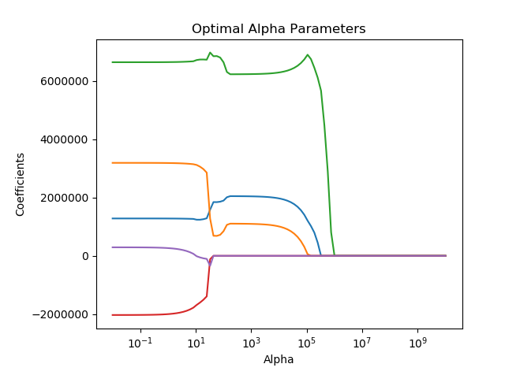
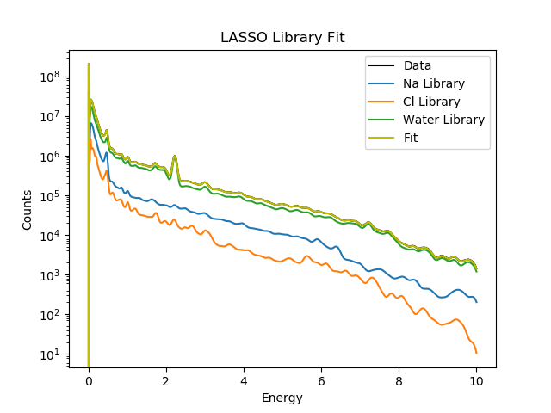
LASSO Simulated Example
Note: 5 libraries are used. Fe and Cu do not contribute to the total spectrum, are given a 0 contribution and selected out of the final model.

Slide 10
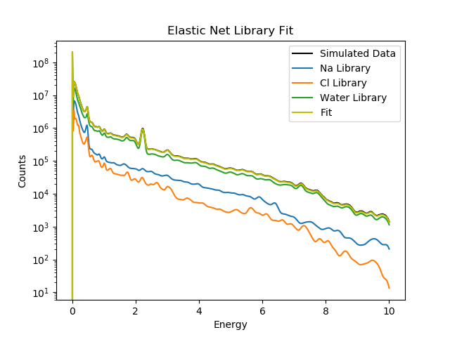
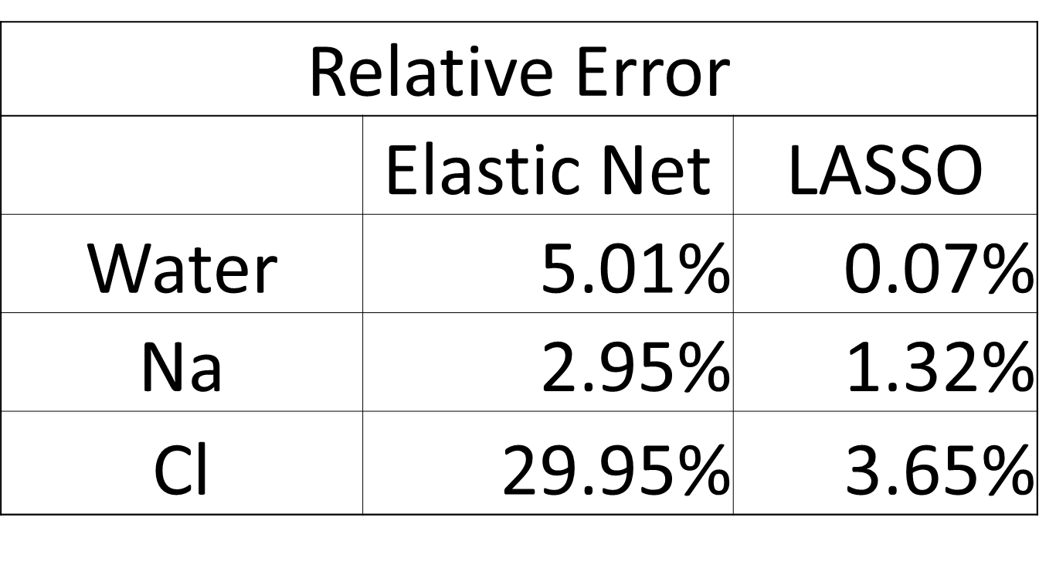
Elastic Net Simulation and Comparison

Slide 11
Sand

Slide 12
Water

Slide 13
Discussion
Questions?

